Slide 1

Apache NIFI Architecture
Presented by :Sonika tiwari

Slide 2
What is Apache NiFi:
Apache NiFi is a software project from the Apache Software foundation. Leveraging the concept of extract , transform and load(ETL).
Apache NiFI enables the automation of data flow between systems. It is like data logistics.
It provide real-time control helps to the manage the movement of data between any source and any destination.

Slide 3
History of Apache NiFi:-
2006:NiagaraFiles(NiFi) was first incepted at National Security Agency(NSA).
November 2014:NiFi is donated to Apache software foundation through as the NSA’S Technology transfer program and enter ASF’s incubator.
July 2015:NiFi reaches to ASF top level project status.

Slide 4
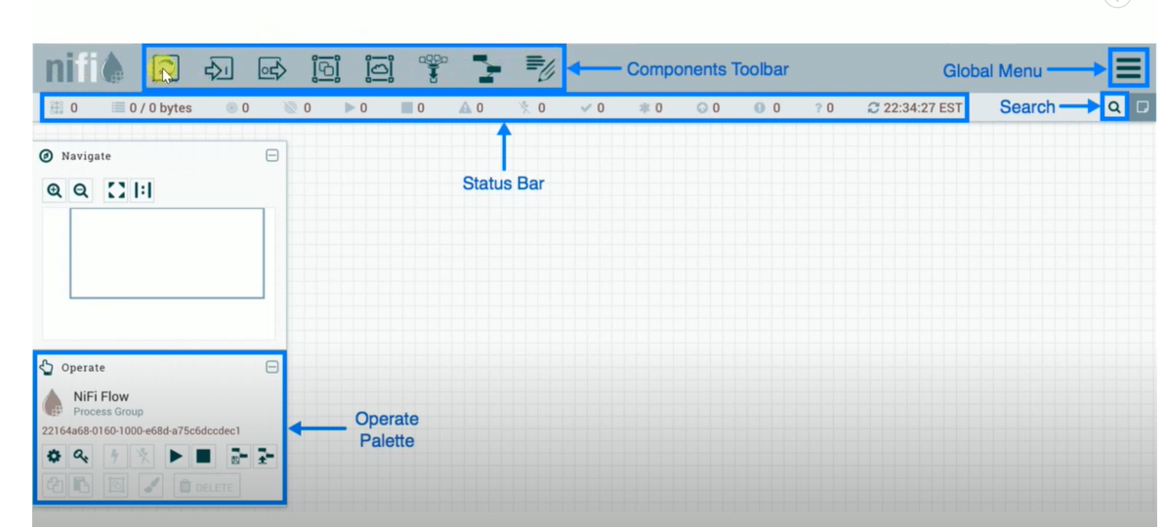
Features Of Apache NiFi :
Browser based user interface: Seamless experience for design, control, feedback, and monitoring.

Slide 5
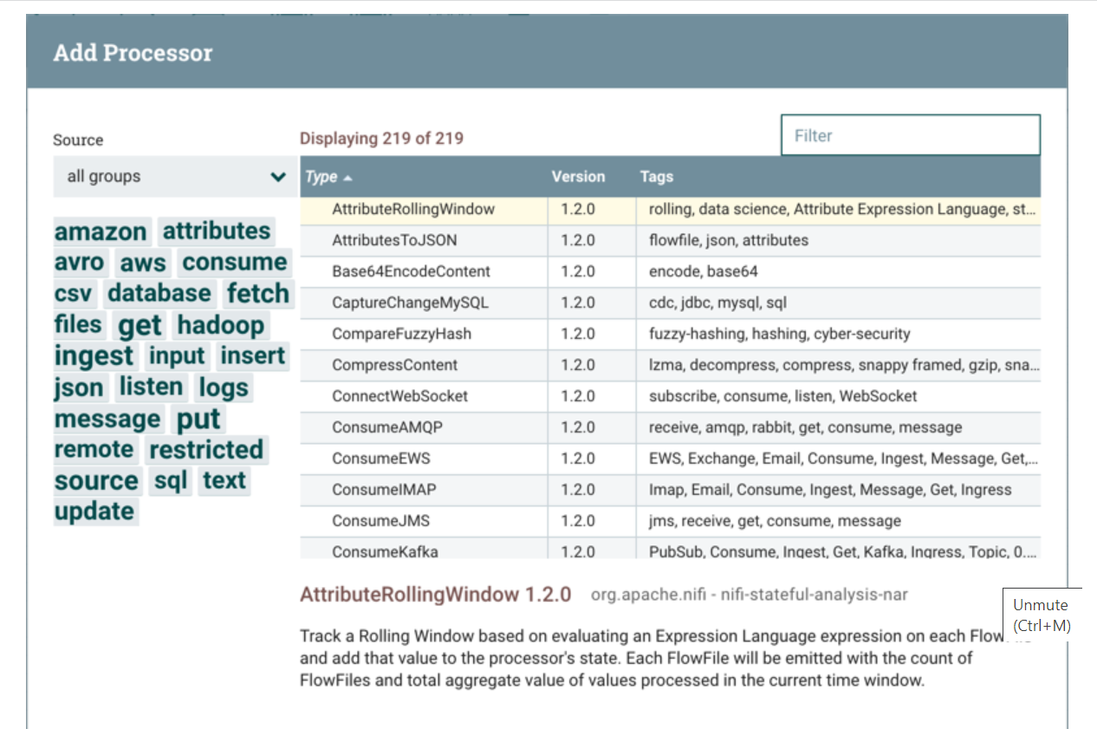

Slide 6
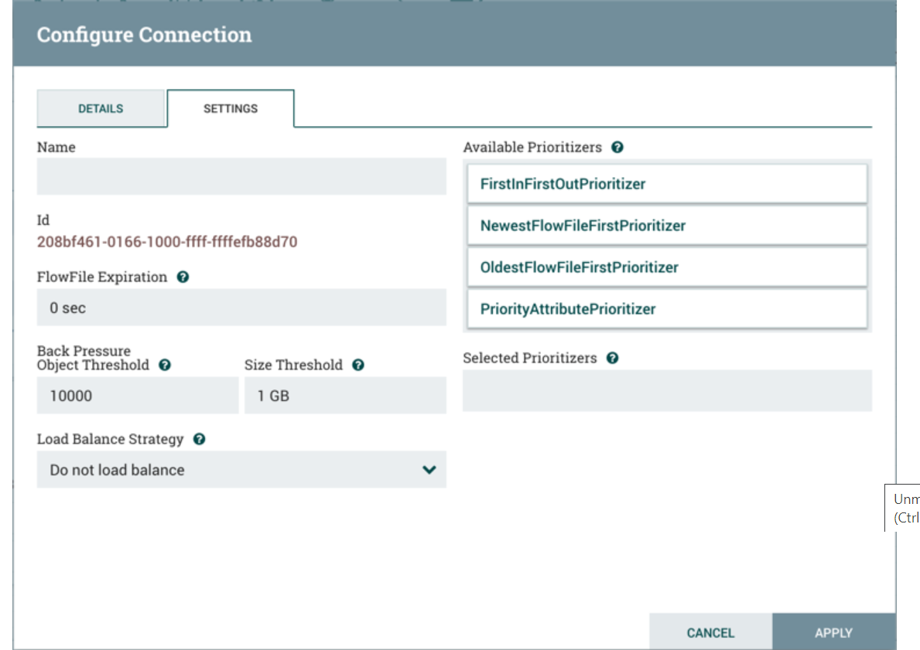

Slide 7
Data provenance tracking: Complete lineage of information from beginning to end.
Extensive configuration: Loss-tolerant and guaranteed delivery
Low latency and high throughput
Dynamic prioritization
Runtime modification of flow configuration
Extensible design: An extensible design refers to creating a system that can be easily expanded or extended
without major modifications to the existing core components.
Secure communication: HTTPS with configurable authentication strategies.
and multi-tenant authorization and policy management

Slide 8
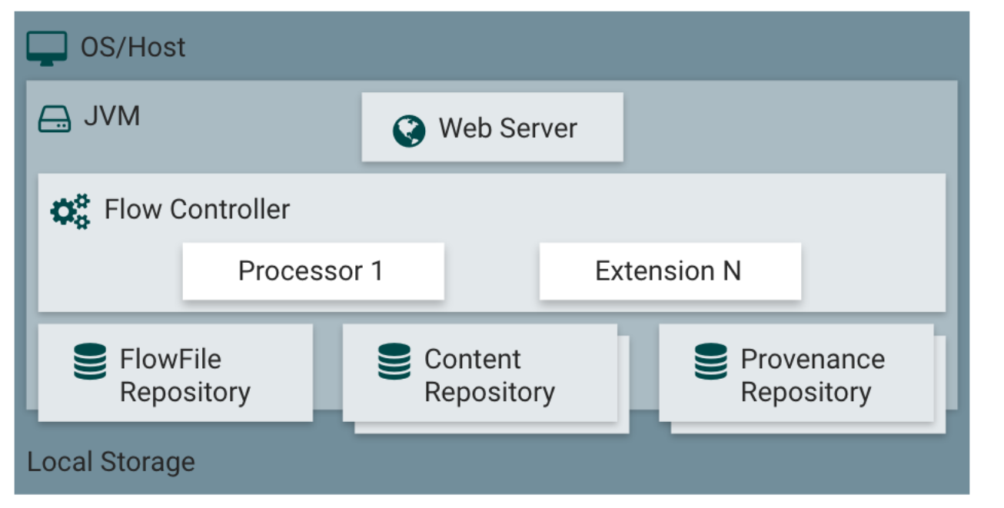
NiFi Architecture:- NiFi executes within a JVM on a host operating system. The primary components of NiFi on the JVM are as follows.

Slide 9
Web Server:
The purpose of the web server is to host NiFi’s HTTP-based command and control API.
Flow Controller:
Processor:
The Processor is the brains of the operation. It provides threads for extensions to run on, and manages the schedule of when extensions receive resources to execute.
Extensions:
Community-contributed extensions available through the NiFi Registry. These extensions can enhance NiFi's capabilities and provide pre-built solutions for various use cases.
.

Slide 10
Local Storage:-
Flow-File Repository:
The Flowfile Repository is where NiFi keeps track of file is presently active in the flow. The implementation of the repository is pluggable.
Content Repository:
The Content Repository is where the actual content bytes of a given FlowFile live. The implementation of the repository is pluggable. The default approach is a fairly simple mechanism, which stores blocks of data in the file system. More than one file system storage location can be specified so as to get different physical partitions engaged to reduce contention on any single volume.

Slide 11
Provenance Repository:
The Provenance Repository is where all the history of data is stored. The repository construct is pluggable with the default implementation being to use one or more physical disk volumes. Within each location event data is indexed and searchable.

Slide 12
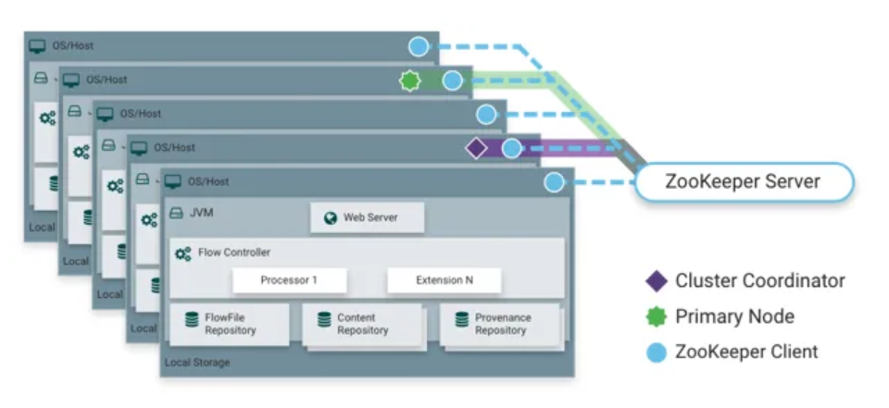
NiFi On cluster Node:- NiFi is also able to operate within a cluster.

Slide 13
In NiFi cluster, each node works on a different set of data, but it performs the same task on the data. Apache Zookeeper chooses a single node as the cluster coordinator and handles the failure automatically. Each node of the cluster reports to the cluster coordinator about heartbeat and status.
Apache Zookeeper elects a single node as the cluster coordinator and failover is automatically handled by Zookeeper.
All cluster nodes report heartbeat and status information to the cluster coordinator.
The cluster coordinator is responsible for disconnecting and connecting nodes
You can interact with the NiFi cluster the user interface of any node. Any changes you make is replicated to
all the node in the cluster.

Slide 14
Thank you

